Slide 1
Computer Vision Metrics
Dr. Umberto Michelucci
umberto.michelucci@hslu.ch

Slide 2
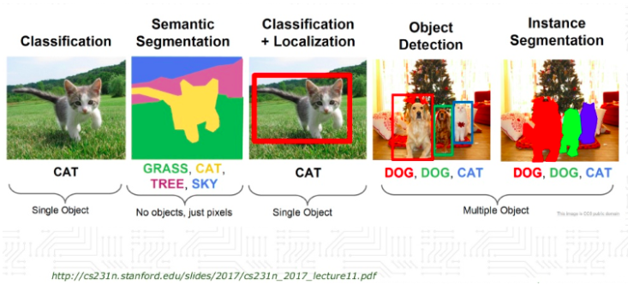

Slide 3
Metrics for Image Classification

Slide 4
Confusion Matrix (binary classification)
Number of inputs classified as 0 and that have a true class of 0 (TRUE POSITIVES, TP)
Number of inputs classified as 1 and that have a true class of 0 (FALSE NEGATIVES, FN)
In the case of the perfect classifier:
FN = 0 and FP = 0
True Label 0
Number of inputs classified as 0 and that have a true class of 1 (FALSE POSITIVES, FP)
Number of inputs classified as 1 and that have a true class of 1 (TRUE NEGATIVES, TN)
True Label 1
Predicted Label 0
Predicted Label 1

Slide 5
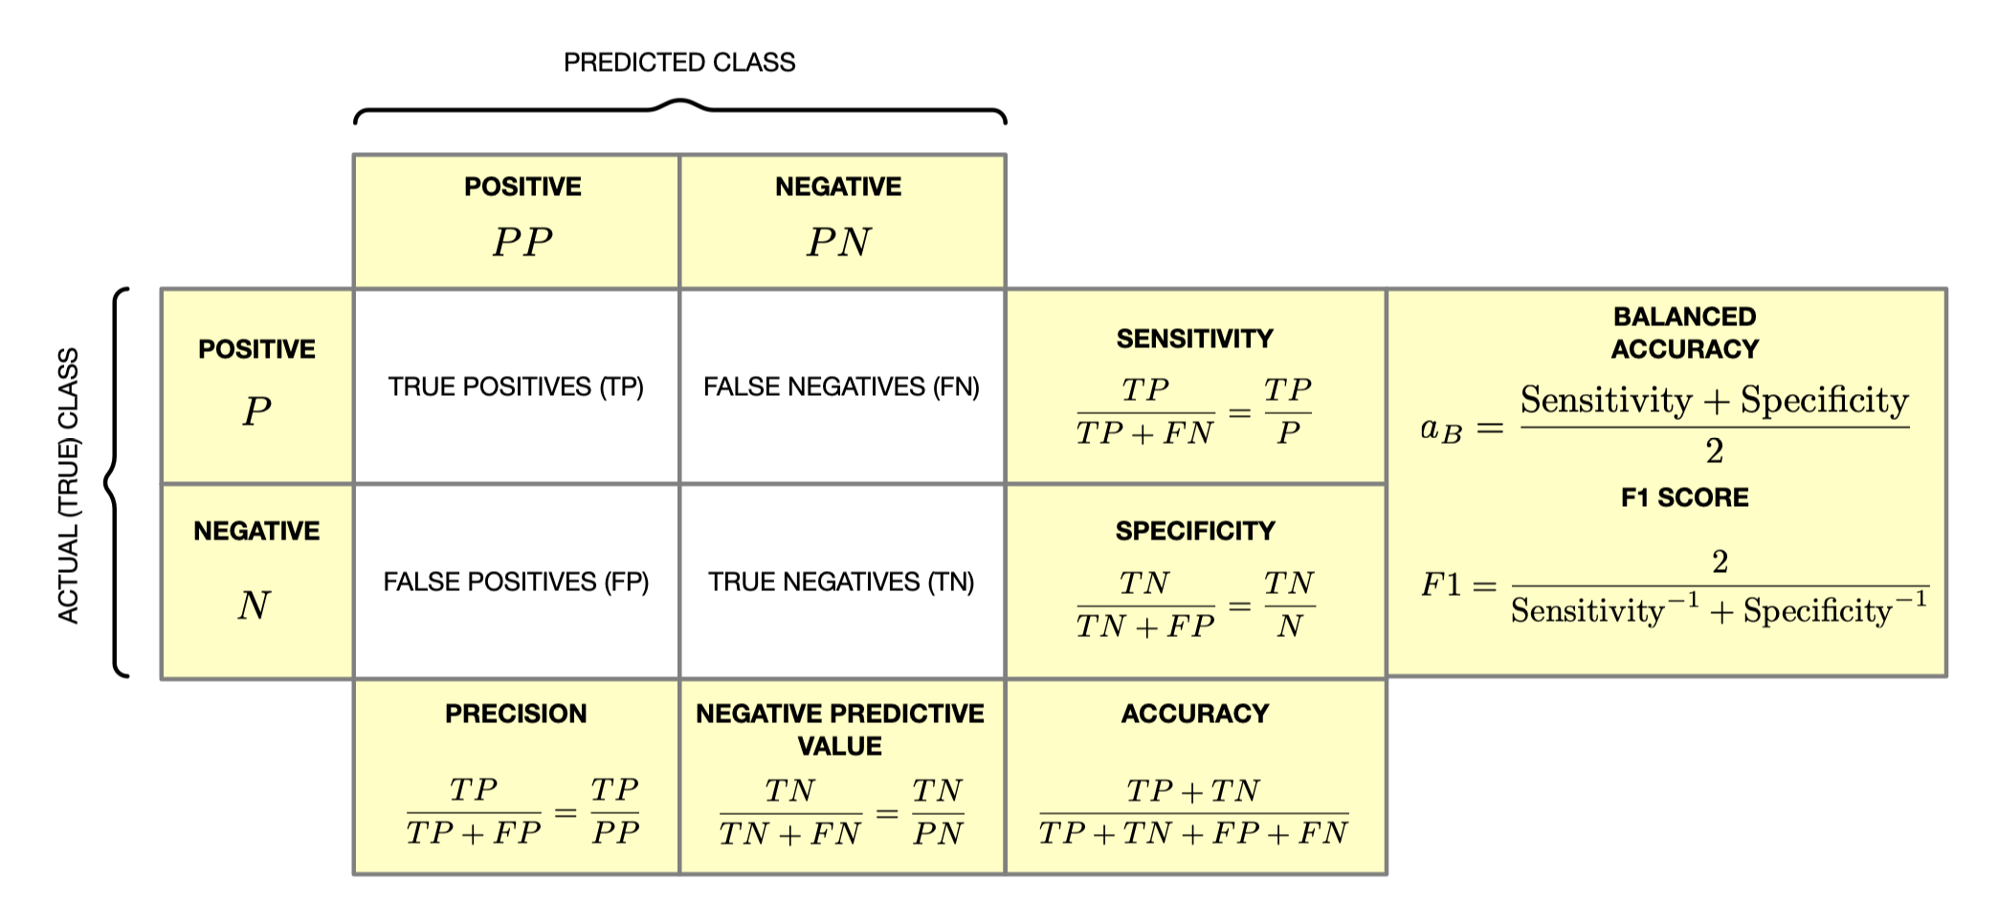
Summary – confusion matrix

Slide 6
Note
All the previos metrics can be used in any segmentation task. You treat each pixel as correctly classified or wrongly classified → So you are dealing with a binary classification problem
But you must be careful when the portion of the image to be segmented is very small. You will easily get high accuracy but the segmentation could be very poor.

Slide 7
Confusion Matrix (Multi-class classification)
Number of inputs classified as 0 and that have a true class of 0
Number of inputs classified as 1 and that have a true class of 0
Number of inputs classified as 2 and that have a true class of 0
…
True Label 0
Number of inputs classified as 0 and that have a true class of 1
Number of inputs classified as 1 and that have a true class of 1
True Label 1
…
…
…
…
…
Predicted Label 0
Predicted Label 1
Predicted Label 2

Slide 8
Metrics for Image Localisation

Slide 9
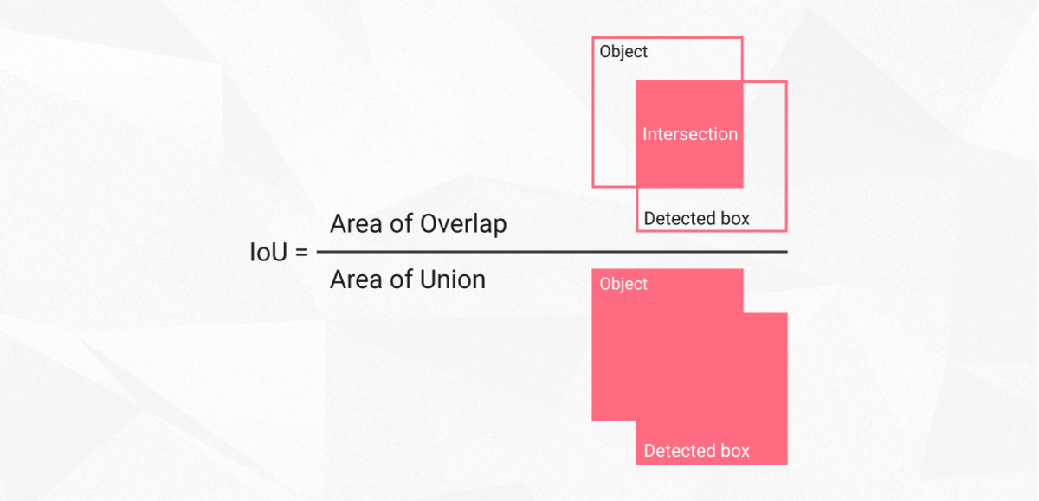
Intersection Over Union (IoU)
Intersection over union is actually a very straightforward and self-explanatory measurement and is based on the Jaccard index (a coefficient for similarity for two sets of data)
https://www.superannotate.com/blog/intersection-over-union-for-object-detection

Slide 10
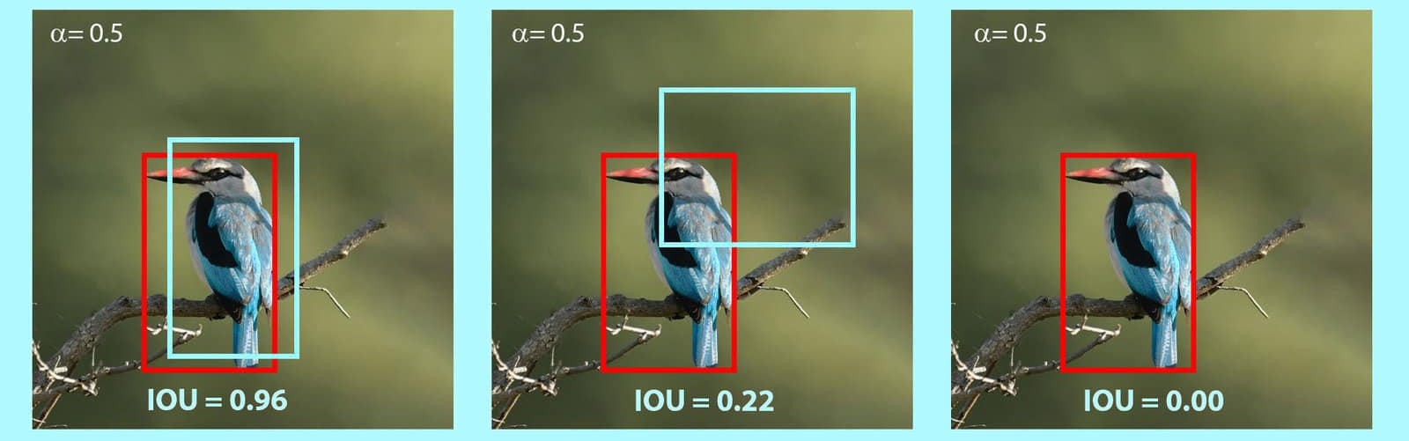
IoU - An example
https://learnopencv.com/intersection-over-union-iou-in-object-detection-and-segmentation/

Slide 11
IoU in image segmentation

Slide 12
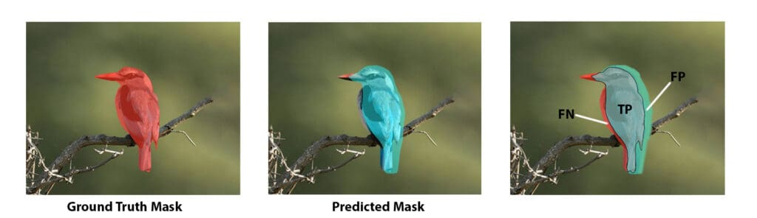
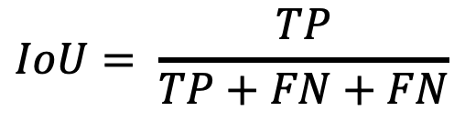
Intersection Over Union (IoU)
$$IoU= \frac{TP}{TP+FN+FN}$$
https://www.superannotate.com/blog/intersection-over-union-for-object-detection

Slide 13
Image Similarity Metrics

Slide 14
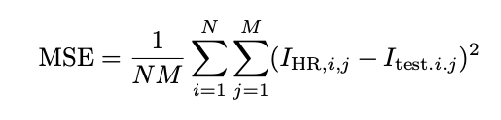
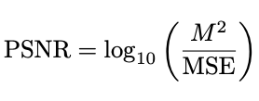

Metrics I/III – MSE and PSNR
The term peak signal-to-noise ratio (PSNR) is an expression for the ratio between the maximum possible value (power) of a signal and the power of distorting noise that affects the quality of its representation. [1]
Reference Image
Test Image
[1] Source: nl.com
Peak Signal to Noise Ratio
Note: PSNR is unbounded

Slide 15



Metrics II/III – Mean Structural Similarity Index
Wang, Z., Bovik, A. C., Sheikh, H. R., and Simoncelli, E. P., “Image quality assessment: from error visibility to structural similarity,” IEEE transactions on image processing 13(4), 600–612 (2004).
Reference Image
Test Image
Contrast
Structure
Luminance
: Mean
: Standard Deviation
: covariance

Slide 16
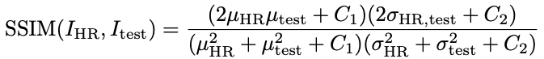
Metrics III/III – Mean Structural Similarity Index
Reference Image
Test Image
Structural Similarity
Index
A circular symmetric Gaussian weighting function with standard deviation of 1.5 pixels and a width of ∆w (∆w = 11 for the HR EEMs, ∆w = 4 for the LR) is applied (to a sliding window), then the mean is obtained MSSIM
: Mean
: Standard Deviation
: covariance

Slide 17
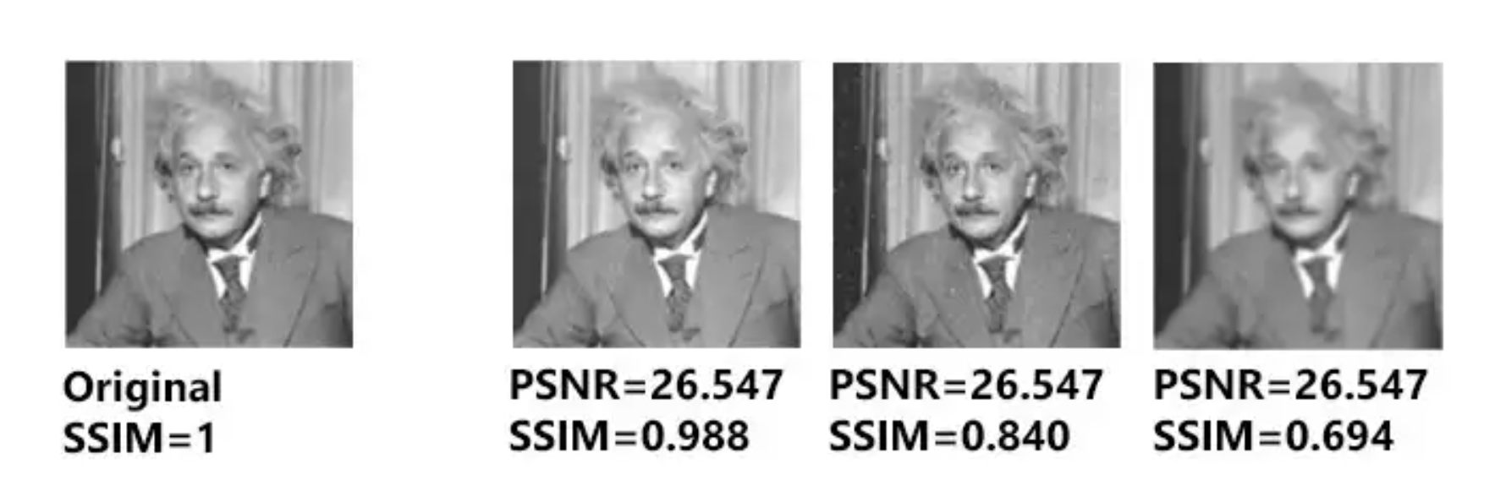
Examples (critic to PSNR)
https://medium.com/@datamonsters/a-quick-overview-of-methods-to-measure-the-similarity-between-images-f907166694ee

Slide 18
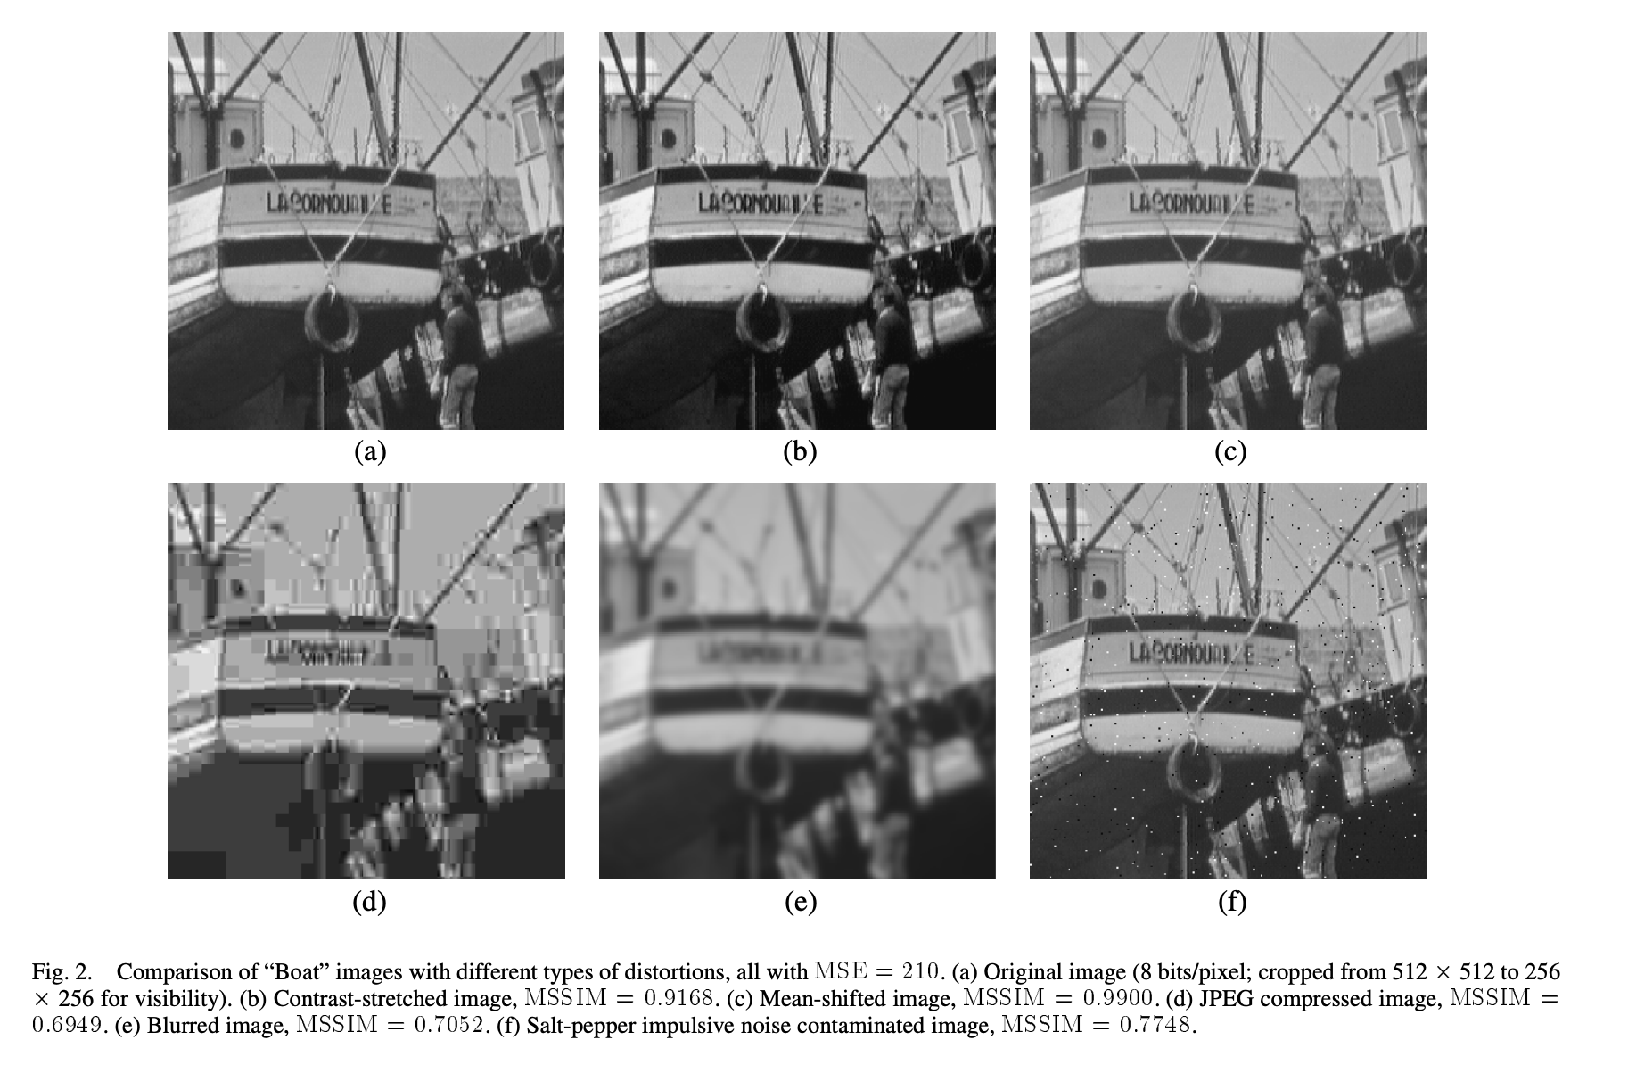
Examples
Wang, Zhou, et al. "Image quality assessment: from error visibility to structural similarity." IEEE transactions on image processing 13.4 (2004): 600-612.

